Slide 1
Building Application REST ful with Express Js
Understand to start application nodejs with Express js
Create module and require it
Render view in express
Developing more:
Backbonejs
MongoDb

Slide 2
EXPRESS JS
Express.js is a Node js web application server framework, which is specifically designed for building single-page, multi-page, and hybrid web applications.
Express is a minimal and flexible Node.js web application framework that provides a robust set of features for web and mobile applications.
It is an open source framework developed and maintained by the Node.js foundation.

Slide 3
Now to create the package.json file :
Create a folder “microproject” on desktop- will act as a project directory
using npm, use the following code.: npm init
Let everything remain default and package.json will be created

Slide 4
package.json file
{
"name": "microproject",
"version": "1.0.0",
"description": "",
"main": "index.js",
"scripts": {
"test": "echo \"Error: no test specified\" && exit 1"
},
"author": "",
"license": "ISC"
}
}

Slide 5
How to setup Express JS?
$ npm install --save express
Express:
-h, --help : Show help command
-V, --version : Version of express
-s, --sessions : Add support session for Express

Slide 6
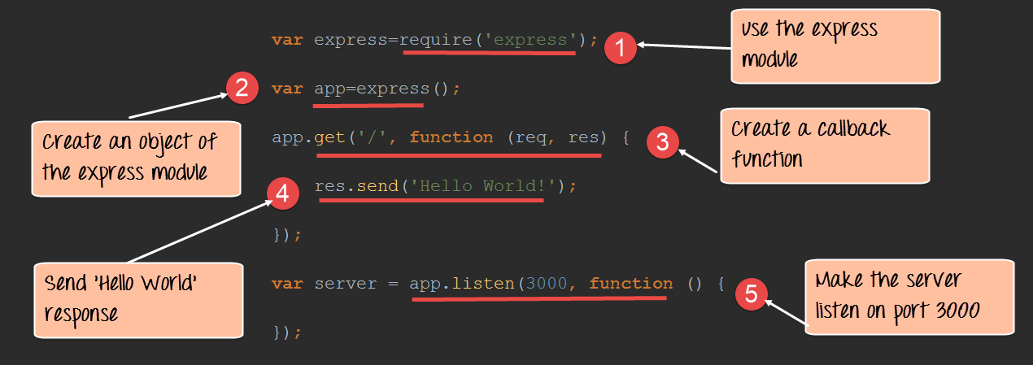
Notes:
With and without parameter

Slide 7
Lets Develop Server Side first “hello world” using EXPRESS
Create a file index.js and write a code:
var express = require('express');
var app = express();
app.get('/', function(req, res)
{ res.send("Hello world!"); } );
app.listen(3000);

Slide 8
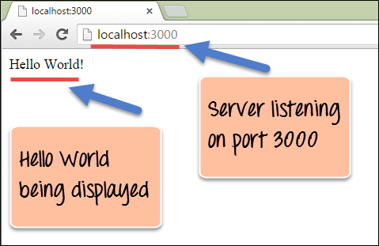
OUTPUT

Slide 9
How to send query request with parameters???
var express = require('express');
var app = express();
app.get('/color', (req, res) => {
console.log(req.query.color1) ;
res.send("Color is : "+ req.query.color1 );
//console.log(req.query.color2) ;
//res.send("Colors are: "+ req.query.color1 + " and "+ req.query.color2);
console.log("colors printing"); });
app.listen(3000);

Slide 10
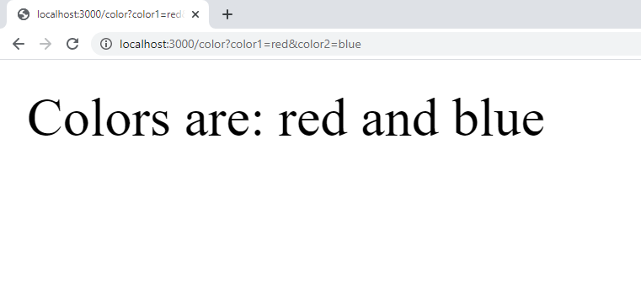

Slide 11
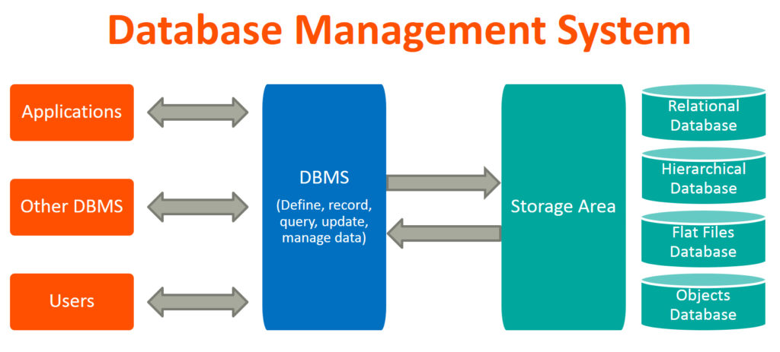
Database
Database is a systematic collection of data.
Database support storage and manipulation of data.
Database Management System (DBMS) is a collection of programs which enables us to:
access data, manipulate data, representation of data
Notes:
Together, the data and the DBMS, along with the applications that are associated with them, are referred to as a database system, often shortened to just database.

Slide 12
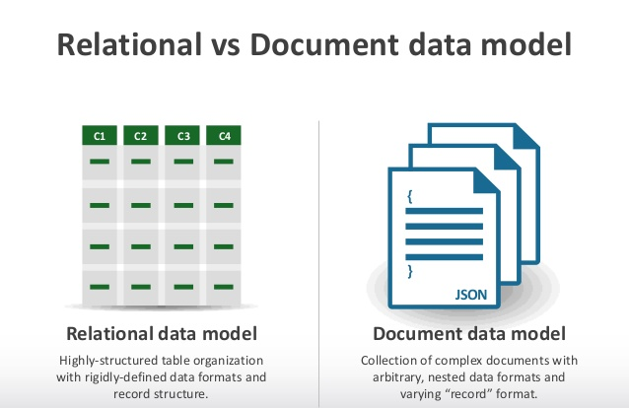
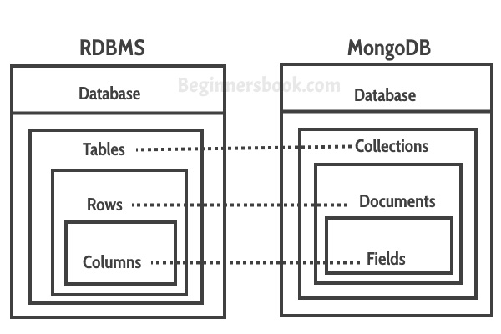

Slide 13
MONGODB
MongoDB is a No SQL database.
It is an open-source, cross-platform, document-oriented database written in C++.
Companies like Google, Flipkart, Facebook, Twitter, Bosch, Nokia, and MTV are all among the major users of MongoDB.

Slide 14
Why Mongo DB?
Development with ease is possible with mongo DB.
MongoDB is a document oriented database that provides
High performance
High availability
Scalability: It is based on distributed database, making it horizontally scalable.
Flexibility: The documents that are inserted are not checked against any schema, which makes the system flexible for handling variety of data.

Slide 15
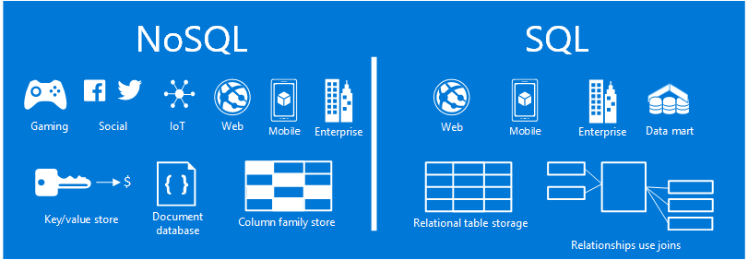
HIGH AVAILABILITY
Notes:
High availability -

Slide 16
Document(JSON) Structure
Data is stored in MongoDB in the form of JSON Style.
JSON is simple structure and very easy to understand the content.
JSON is smaller, faster and lightweight.
For data delivery between servers and browsers, JSON is a better choice
Easy in parsing and processing the data.
[
{
"Name": "Tom",
"Age": 30,
"Role": "Student",
"University": "CU",
}
{
"Name": “Sam",
"Age": 32,
"Role": "Student",
"University": “OU",
}
]

Slide 17
INSTALLATION OF MONGODB
To install mongoDB, go to this link and click on the appropriate OS and architecture: http://www.mongodb.org/downloads
Click on downloaded file and start installing.
After installation click on next till you get Finish button.
Create a data directory on C:\ for mongoDB to use i.e. “data” followed by “data\db”.
Open your mongodb/bin directory and run mongod.exe to start the database server.
To establish a connection to the server, open another command prompt window and go to the same directory, entering in mongo.exe. This engages the mongodb shell.

Slide 18
To Create Database
To Create a new db
use <name>
To check which db you’re using
db
To show all databases
show dbs
To show all collections
show collections

Slide 19
The insert() Method
To insert data into MongoDB collection, we use MongoDB's insert() method.
Syntax of insert():
db.COLLECTION_NAME.insert(document)

Slide 20
The find() Method
To query data from MongoDB collection, we use MongoDB's find() method.
Syntax of find() method:
db.COLLECTION_NAME.find()
find() method will display all the documents in a non-structured way.
To display the results in a formatted way, we can use pretty() method.
db.mycol.find().pretty()

Slide 21
Query Document using find()
Matching criteria
db.employees.find({"name":"raju"})
Greater than search criteria
db.employees.find({salary:{$gt:30000} })
Less than search criteria
db.employees.find({age:{$lt:30}})
in operator:
db.employees.find({age:{$in: [23,32]} })
Above command retrieves the documents from the employees collection where age equals either 23 or 32

Slide 22
The update() Method
MongoDB’s update() method updates the values in the existing document.
db.COLLECTION_NAME.update(SELECTION_CRITTERIA,UPDATED_DATA)
db.COLLECTION_NAME.updateMany(SELECTION_CRITTERIA,UPDATED_DATA)

Slide 23
The delete()/remove() Method
MongoDB’s delete()/remove() method is used to remove a document from the collection. db.COLLECTION_NAME.remove(DELLETION_CRITTERIA)
db.COLLECTION_NAME.deleteOne(DELLETION_CRITTERIA) db.COLLECTION_NAME.deleteMany(DELLETION_CRITTERIA)

Slide 24
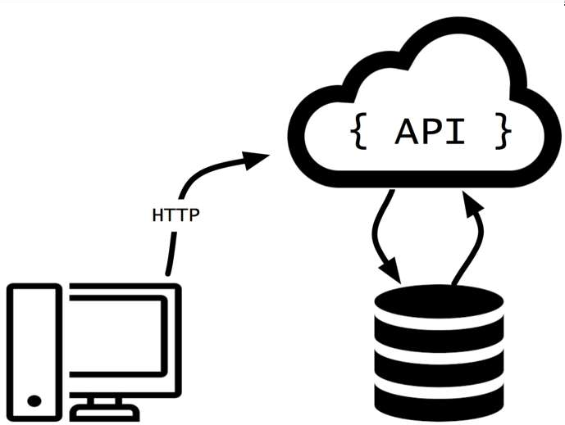
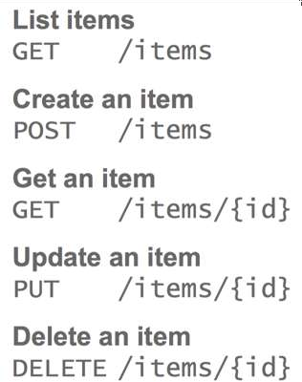

Slide 25
Getting Started with our Project
Problem Statement:
Inventory management of critical health care infrastructure including real time usage tracking has become inevitable following the current pandemic. This project aims at building an inventory tracking system for ventilators that allows authorized hospital users to input details of the available inventory and tag it as “occupied”, “available” and “in-maintenance”. The three status can also be updated using a secure API for real time usage metrics. The application should have the ability to also add any ventilator to a specific hospital and search ventilators which are available.

Slide 26
Database as hospitalManagement
Collection 2: Ventilator Details
Collection 1: Hospital Deatils

Slide 27
Collection 1: Hospital:
{
"hId":"H1",
"name": "Apollo hospital",
"location":"17.398644, 78.484334",
"address": "Plot No. 3-5-874/1 Near, Old MLA Quarters Rd, Hyderguda,Hyderabad,Telangana 500029",
"contactNo": "040-23231380“
}

Slide 28
Collection 2: Ventilators:
{
"hId" : "H1",
"ventilatorId" : "H1V5",
"status" : "occupied",
"name" : "Apollo hospital"
}

Slide 29
API to be built:
1. Read Hospital and Ventilator Details
2. Search Ventilators by status and hosp name
3. Search Hospital by name
4. Update Ventilators Details
5. Add Ventilator
6. Delete Ventilator by Vent ID

